Slide 1

Hello!
I am Arshak Rezvani
You can find me at @ArshakRz

Slide 2

Comparison of Multi-Channel EEG Based Graph Learning Methods
Supervisor: Dr. Mohammad B. Shamsollahi
#WomanLifeLiberty

Slide 3
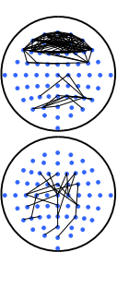
What I Want To Do? [4]

Slide 4
Data Set
Two Class:
Imagining Moving Foot
Doing Math
10-20 Recording System
165 Trials
30 Channels
AFz, F7, F3, Fz, F4, F8, FC3, FCz, FC4, T7, C3, Cz, C4, T8, CP3, CPz, CP4, P7, P5, P3, P1, Pz, P2, P4, P6, P8, PO3, PO4, O1, and O2.
256 Points
256 Hz
Notch Filter 50 Hz
Bandpass [0.5 100] Hz
ICA

Slide 5
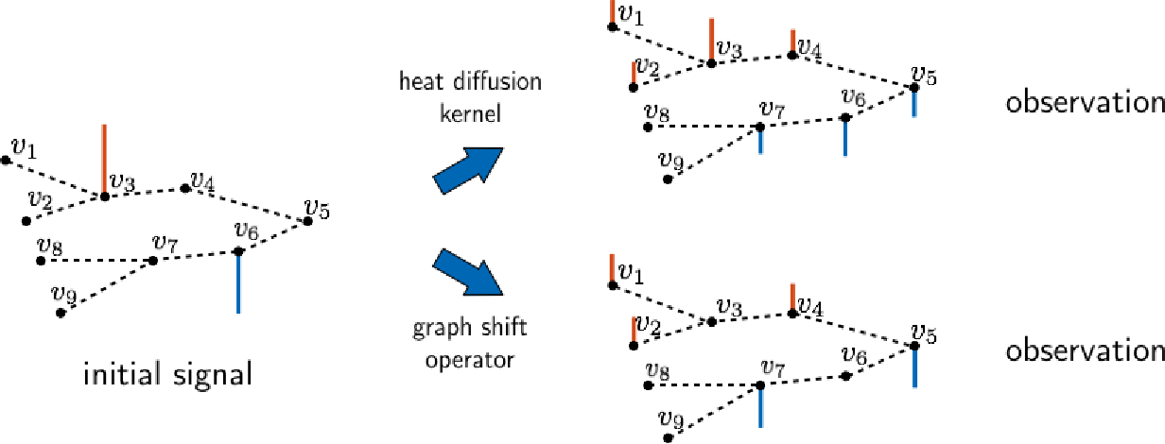
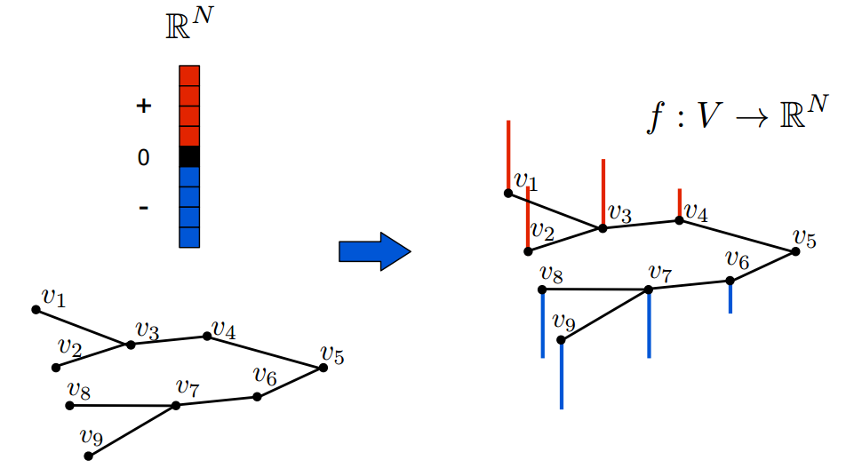
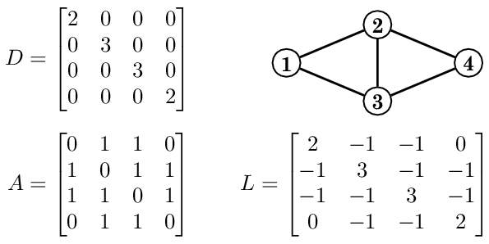
But What is a Graph Signal?
Graph Representations
Adjacency Matrix
Laplacian Matrix
A Vector on a Graph!
It is a Signal
Graph Shift
Graph Fourier Transform(GDFT)
Graph Filtering and Convolution
Initial Signal
Shifted Signal

Slide 6
There Are Three Approaches
One by One
Optimization Problem
Morphological Approach

Slide 7
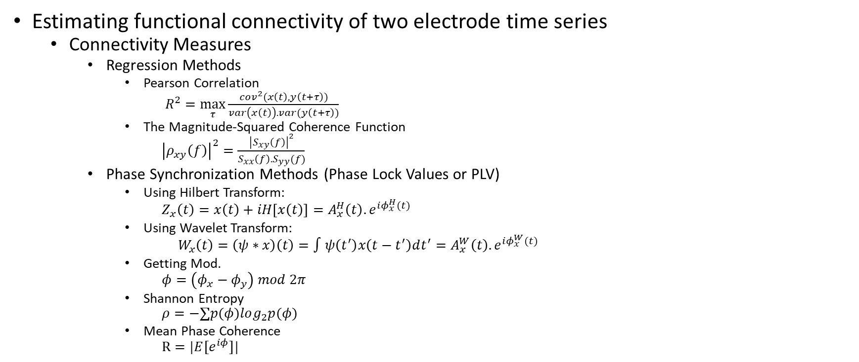
Graph Learning Approach I [3]
Estimating functional connectivity of two electrode time series
Connectivity Measures
Regression Methods
Pearson Correlation
$R^{2}=\max_{τ}{\frac{cov^{2}(x\left(t\right),y\left(t+τ\right))}{var\left(x\left(t\right)\right).var(y\left(t+τ\right))}}$
The Magnitude-Squared Coherence Function
${\left|ρ_{xy}\left(f\right)\right|}^{2}=\frac{{\left|S_{xy}\left(f\right)\right|}^{2}}{S_{xx}\left(f\right).S_{yy}(f)}$
Phase Synchronization Methods (Phase Lock Values or PLV)
Using Hilbert Transform:
$$Z_{x}\left(t\right)=x\left(t\right)+iH\left[x\left(t\right)\right]=A_{x}^{H}\left(t\right).e^{iφ_{x}^{H}(t)}$$
Using Wavelet Transform:
$$W_{x}\left(t\right)=\left(ψ∗x\right)\left(t\right)=∫ψ\left(t^{′}\right)x\left(t−t^{′}\right)dt^{′}=A_{x}^{W}\left(t\right).e^{iφ_{x}^{W}(t)}$$
Getting Mod.
$$φ=\left(φ_{x}−φ_{y}\right) mod 2π$$
Shannon Entropy
$$ρ=−∑p(φ)log_{2}p(φ)$$
Mean Phase Coherence
$$R=|E[e^{iφ}]|$$

Slide 8
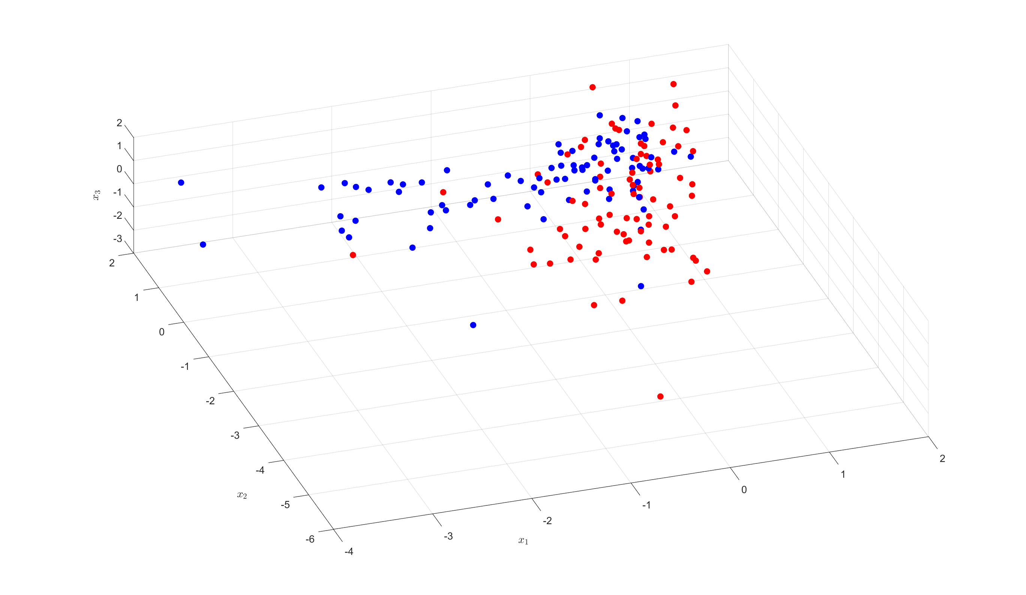
Results
Correlation between channels
Features:
Weights
Graph Frequencies (Eigen Values of Laplacian)
465 features
Chose 10 using mRMR
Classifier:
AdaBoost

Slide 9
Learning Graphs From A Smooth Signal [4]
Not Using the smoothness and time series properties
Learning the Laplacian as a whole

Slide 10
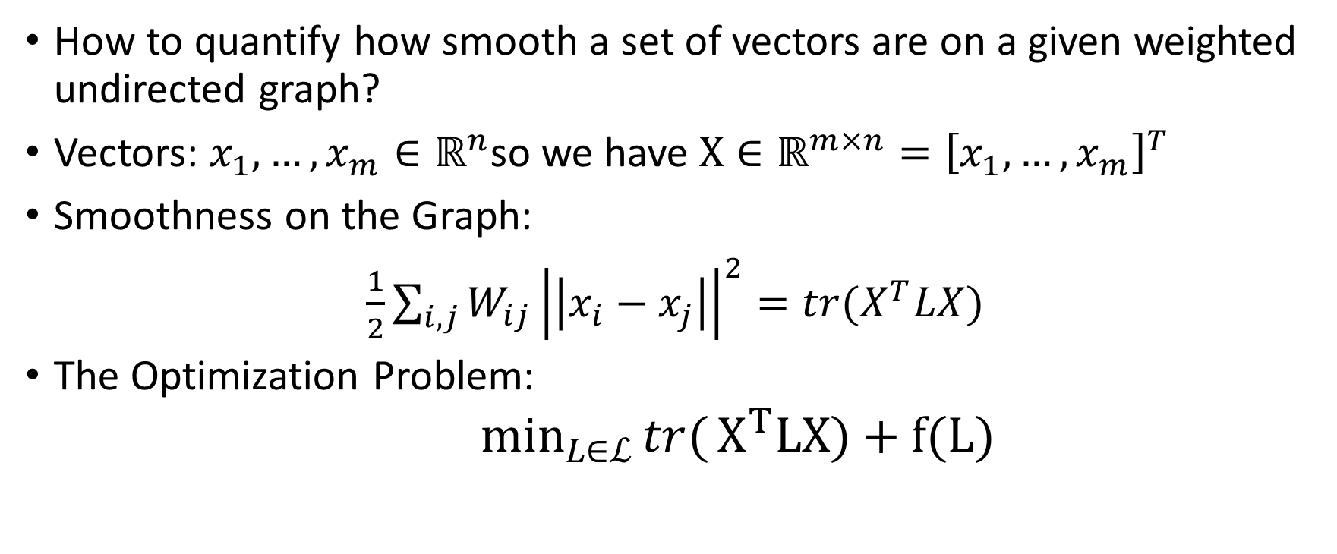
Smoothness On a Graph Definition [4]
How to quantify how smooth a set of vectors are on a given weighted undirected graph?
Vectors: $x_{1}, …, x_{m}∈ℝ^{n}$so we have $X∈ℝ^{m×n}={\left[x_{1}, …, x_{m}\right]}^{T}$
Smoothness on the Graph:
$\frac{1}{2}\sum_{i,j}{W_{ij}}{\left|\left|x_{i}−x_{j}\right|\right|}^{2}=tr(X^{T}LX)$
The Optimization Problem:
$\min_{L∈ℒ}{tr(}X^{T}LX)+f(L)$

Slide 11
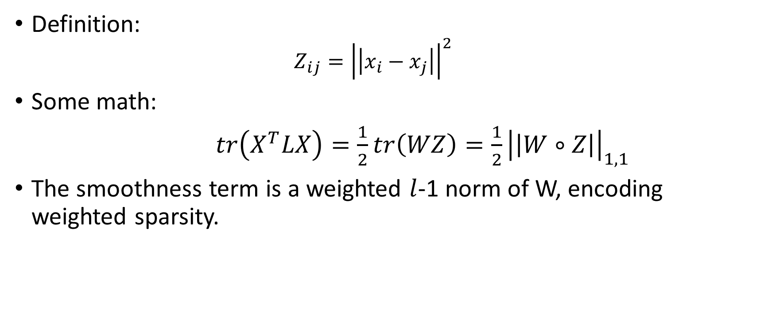
Pairwise Distance Matrix [4]
Definition:
$$Z_{ij}={\left|\left|x_{i}−x_{j}\right|\right|}^{2}$$
Some math:
$tr\left(X^{T}LX\right)=\frac{1}{2}tr\left(WZ\right)=\frac{1}{2}{\left|\left|W∘Z\right|\right|}_{1,1}$
The smoothness term is a weighted $l$-1 norm of W, encoding weighted sparsity.

Slide 12
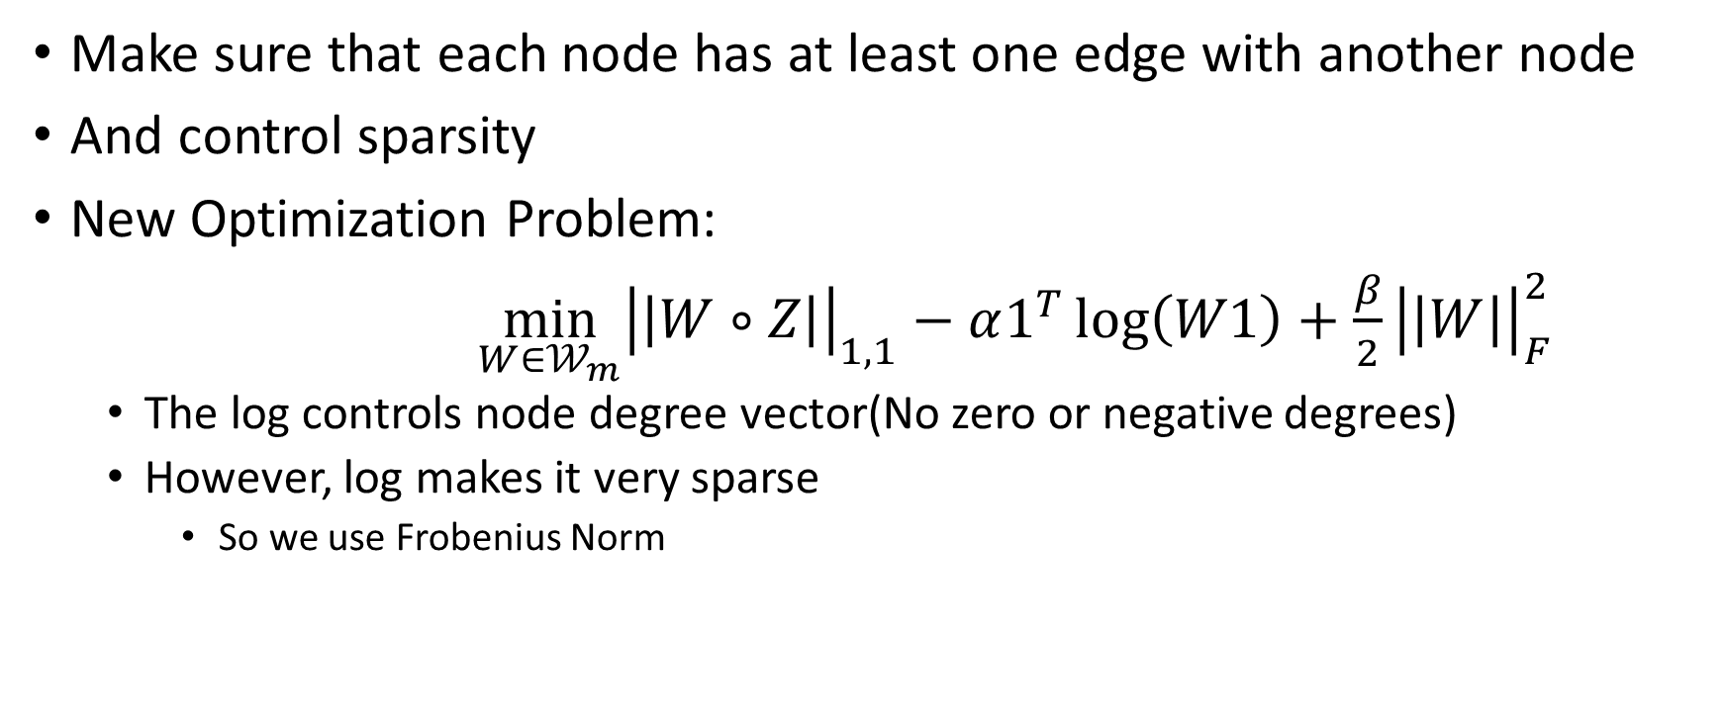
Other Constraint [4]
Make sure that each node has at least one edge with another node
And control sparsity
New Optimization Problem:
$\min_{W∈𝒲_{m}}{{\left|\left|W∘Z\right|\right|}_{1,1}}−α1^{T}\log\left(W1\right)+\frac{β}{2}{\left|\left|W\right|\right|}_{F}^{2}$
The log controls node degree vector(No zero or negative degrees)
However, log makes it very sparse
So we use Frobenius Norm

Slide 13
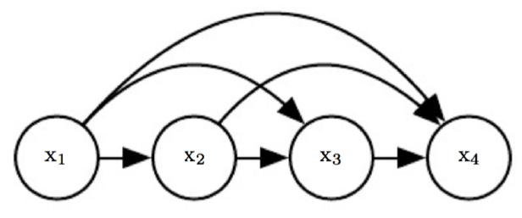
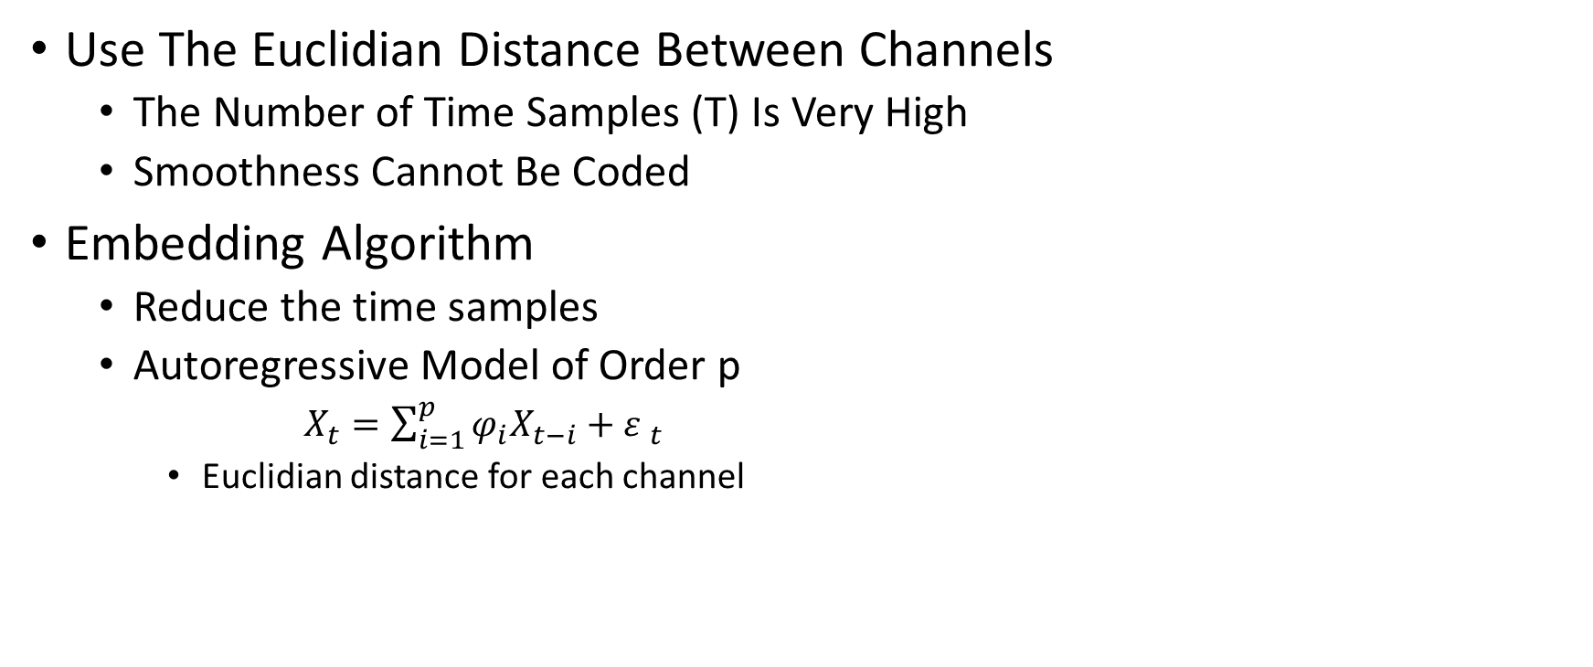
Building the Pairwise Distance Matrix(Z) [1]
Use The Euclidian Distance Between Channels
The Number of Time Samples (T) Is Very High
Smoothness Cannot Be Coded
Embedding Algorithm
Reduce the time samples
Autoregressive Model of Order p
$X_{t}=\sum_{i=1}^{p}{φ_{i}X_{t−i}}+{ε }_{t}$
Euclidian distance for each channel

Slide 14
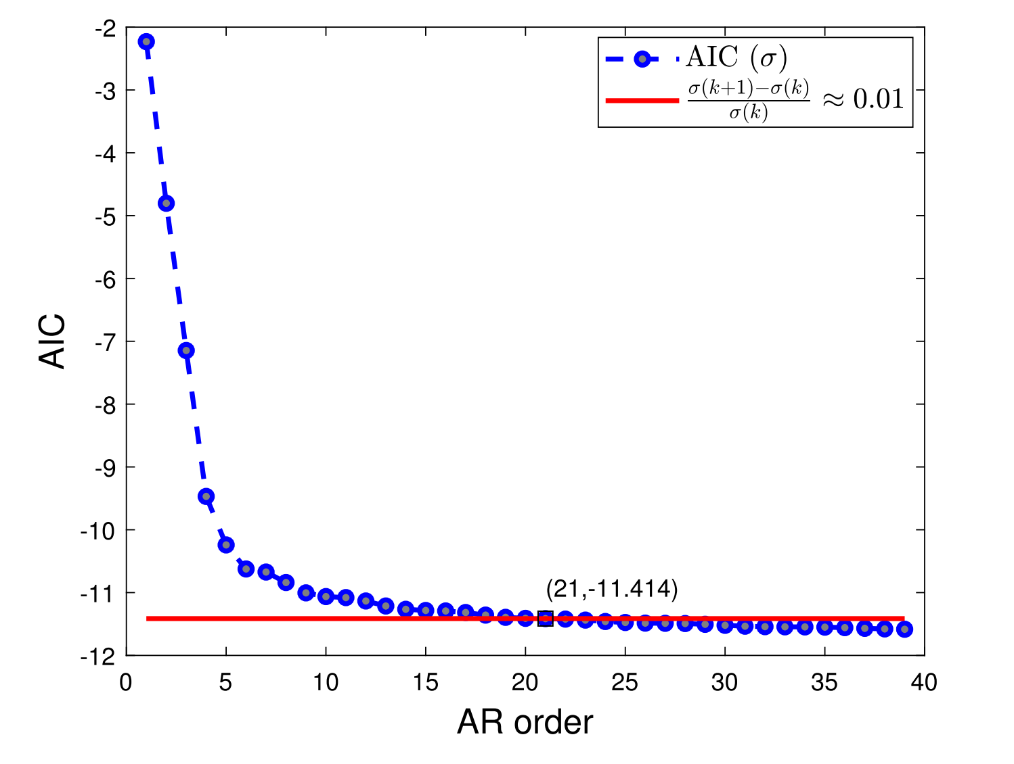
Order Of The AR [1]

Slide 15
Results (Distance Of Times Series For Z)

Slide 16
Results
Used Distance Of Times Series For Z
Features:
Weights
Graph Frequencies (Eigen Values of Laplacian)
465 features
Chose 10 using mRMR
Classifier:
AdaBoost

Slide 17
Results (AR Model For Z)

Slide 18
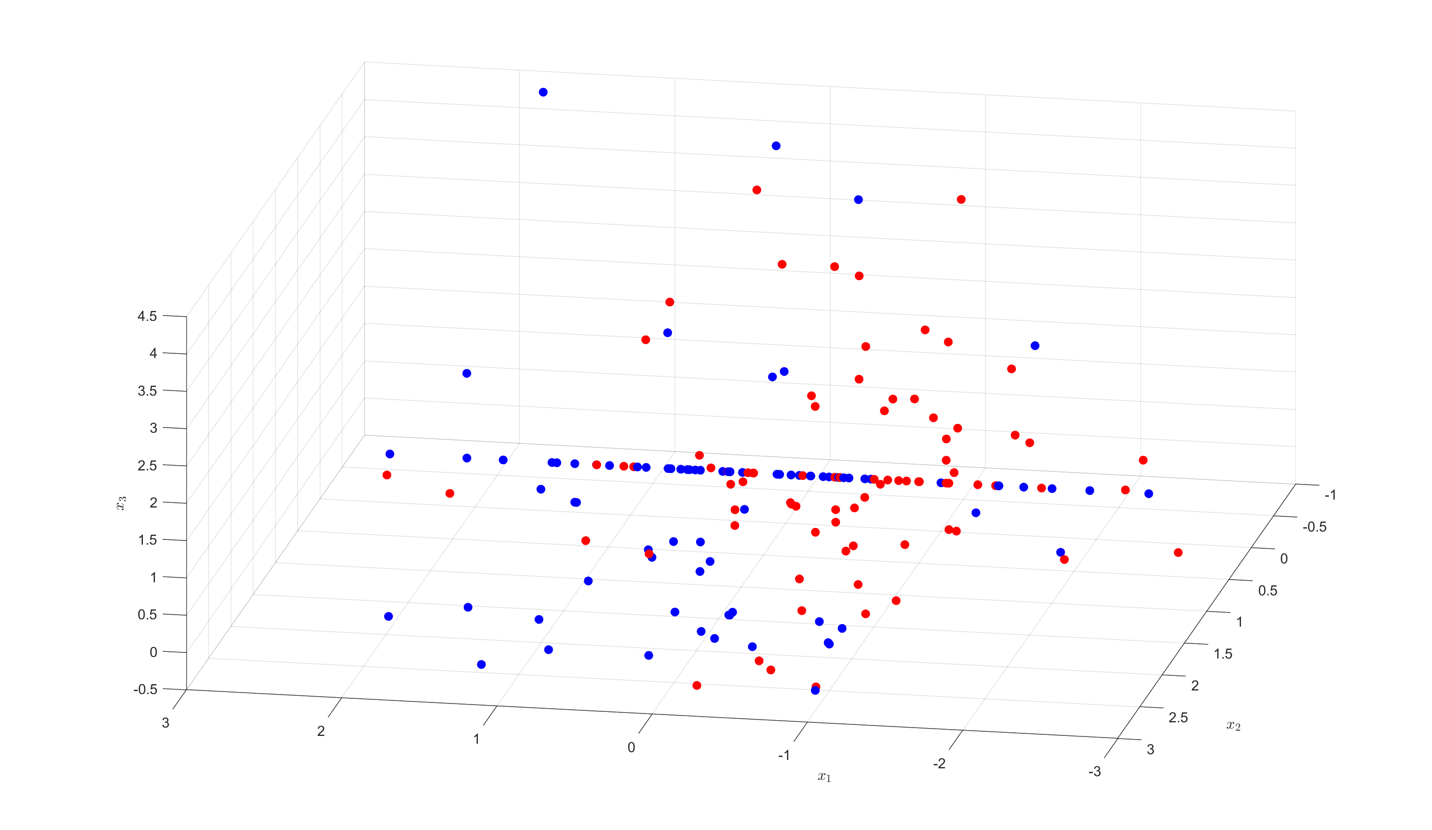
Results
Used AR Model For Z
Features:
Weights
Graph Frequencies (Eigen Values of Laplacian)
465 features
Chose 10 using mRMR
Classifier:
AdaBoost

Slide 19
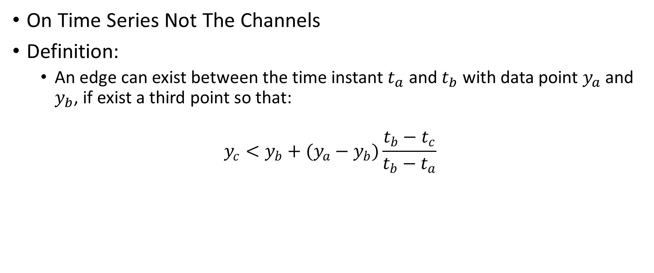
Morphological Approach [2]
On Time Series Not The Channels
Definition:
An edge can exist between the time instant $t_{a}$ and $t_{b}$ with data point $y_{a}$ and $y_{b}$, if exist a third point so that:
$$y_{c}<y_{b}+(y_{a}−y_{b})\frac{t_{b}−t_{c}}{t_{b}−t_{a}}$$

Slide 20
Definition

Slide 21

Results
Visibility Graph for Each Channel
Features:
Graph PSD (GFDT Energy) of Signal
$X_{GDFT}=U^{H}X$ (U is the EVD of Laplacian)
$PSD=\frac{(\sum_{i=1}^{N}{{\left|X_{GDFT}\left(i\right)\right|}^{2})}}{N}$
30 features
Chose 1 Using mRMR (Which Channel?)
Classifier:
SVM With RBF Kernel

Slide 22
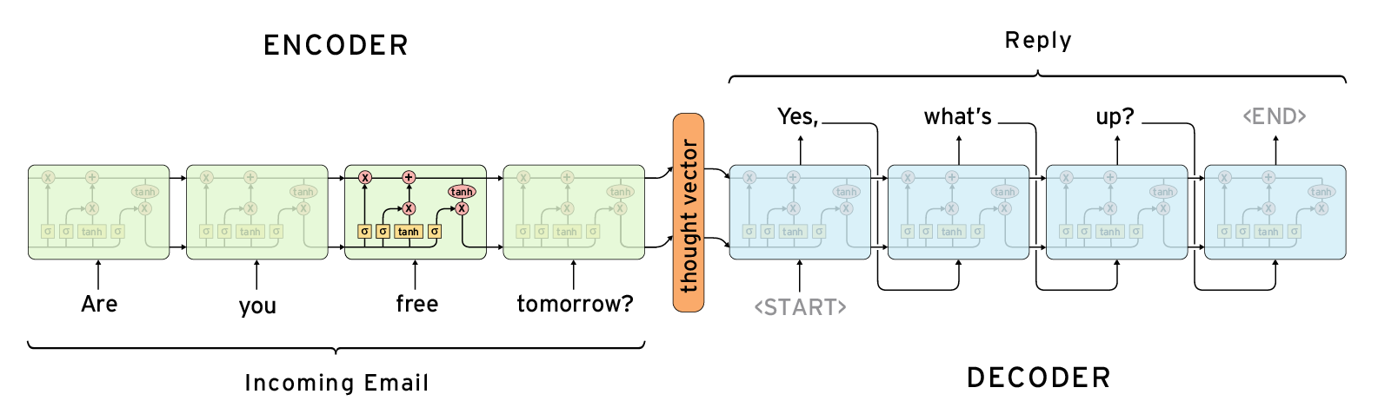
LSTM Autoencoder
Noiseless sequential representation
Latent Space of Encoder-Decoder
Each channel time series is windowed

Slide 23
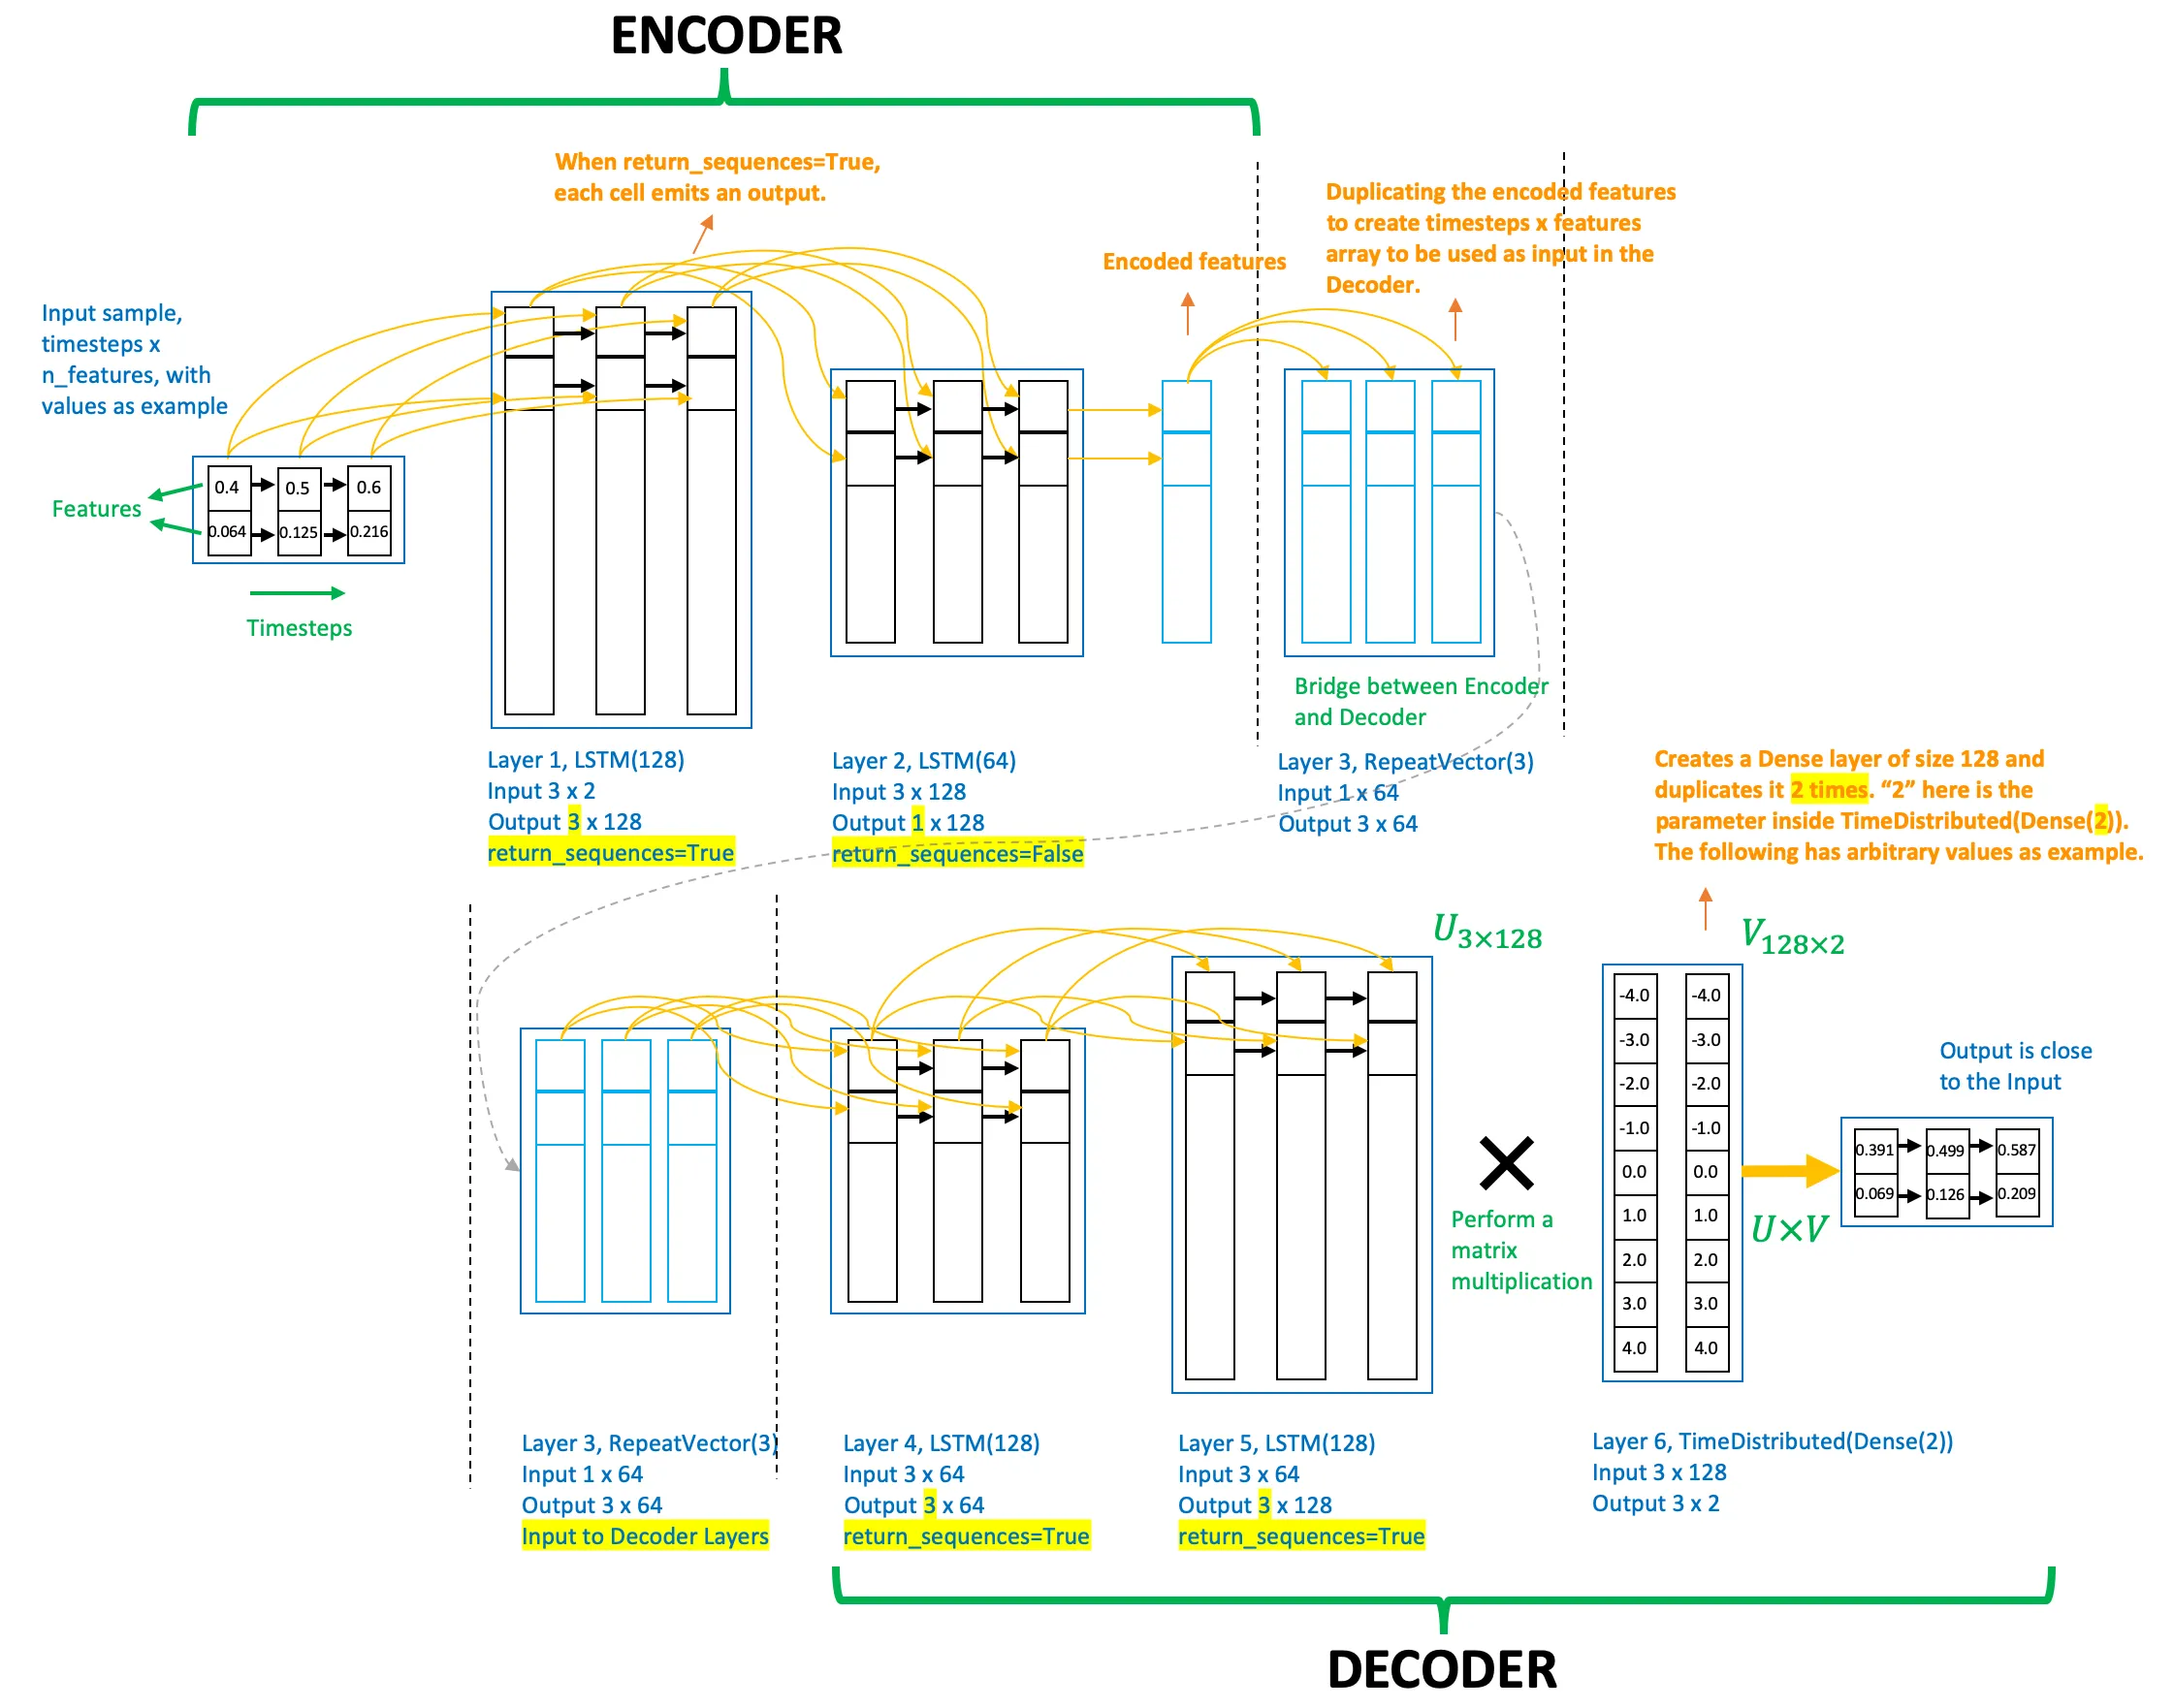
LSTM Autoencoder

Slide 24
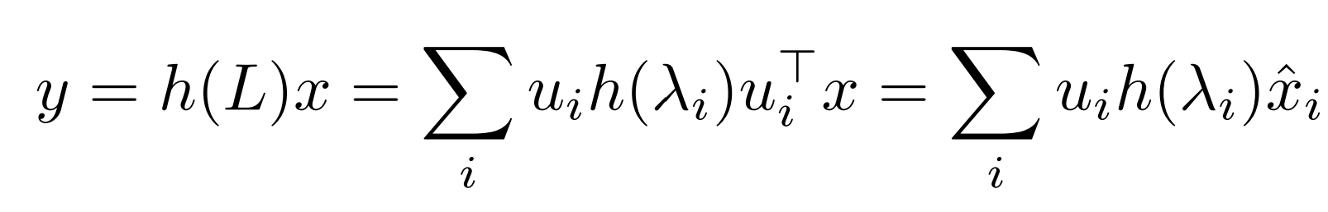
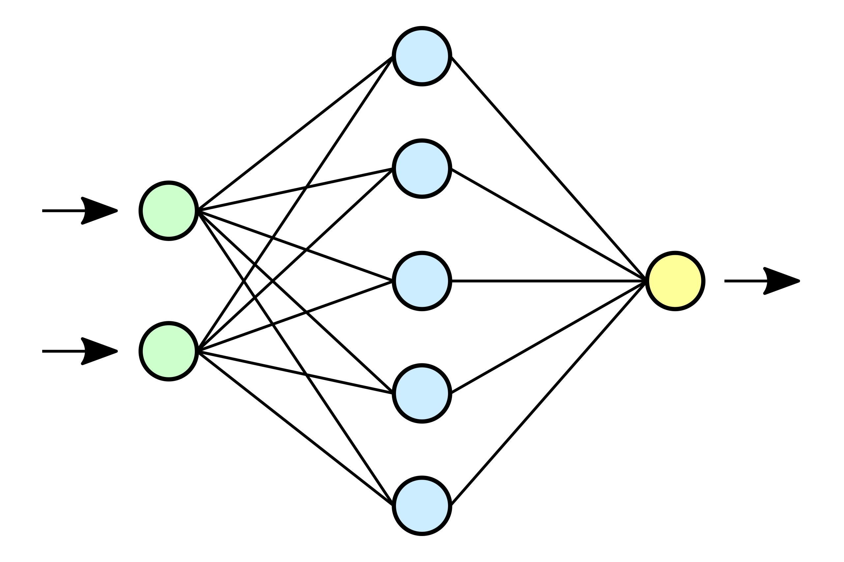
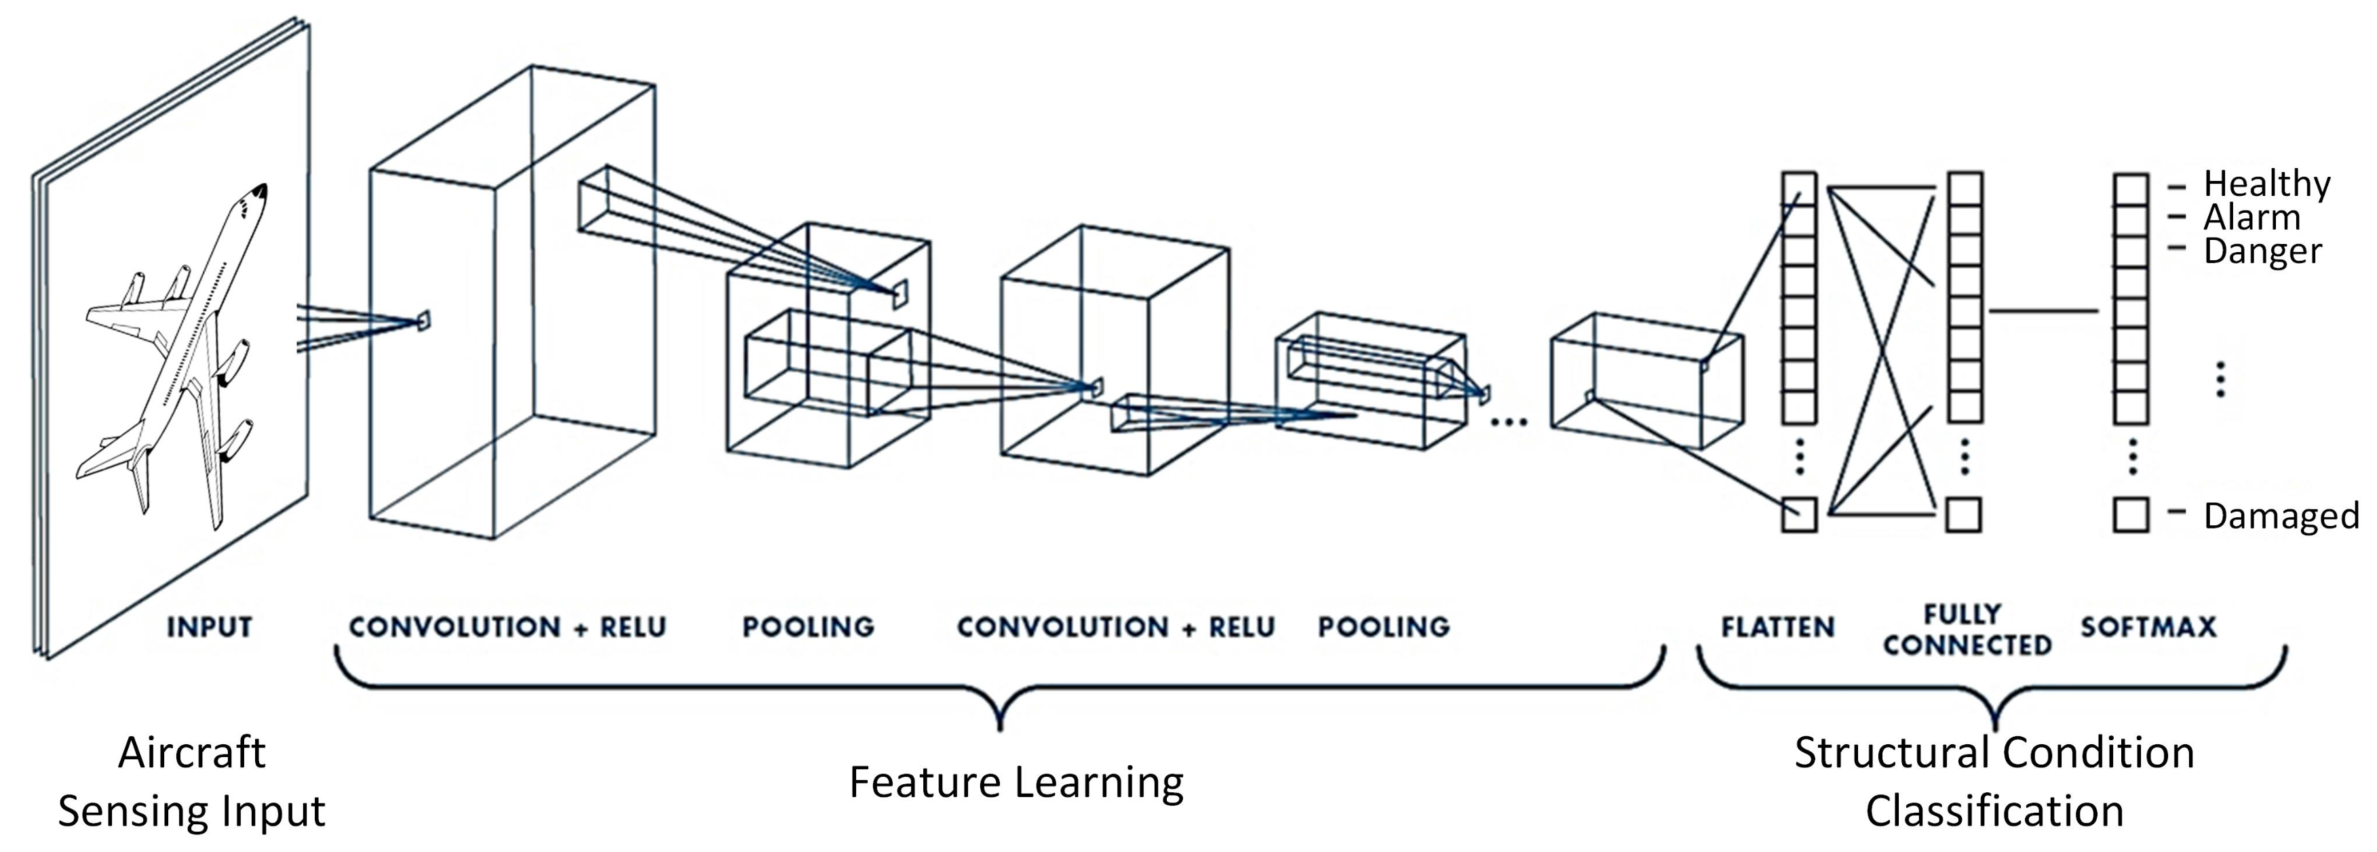
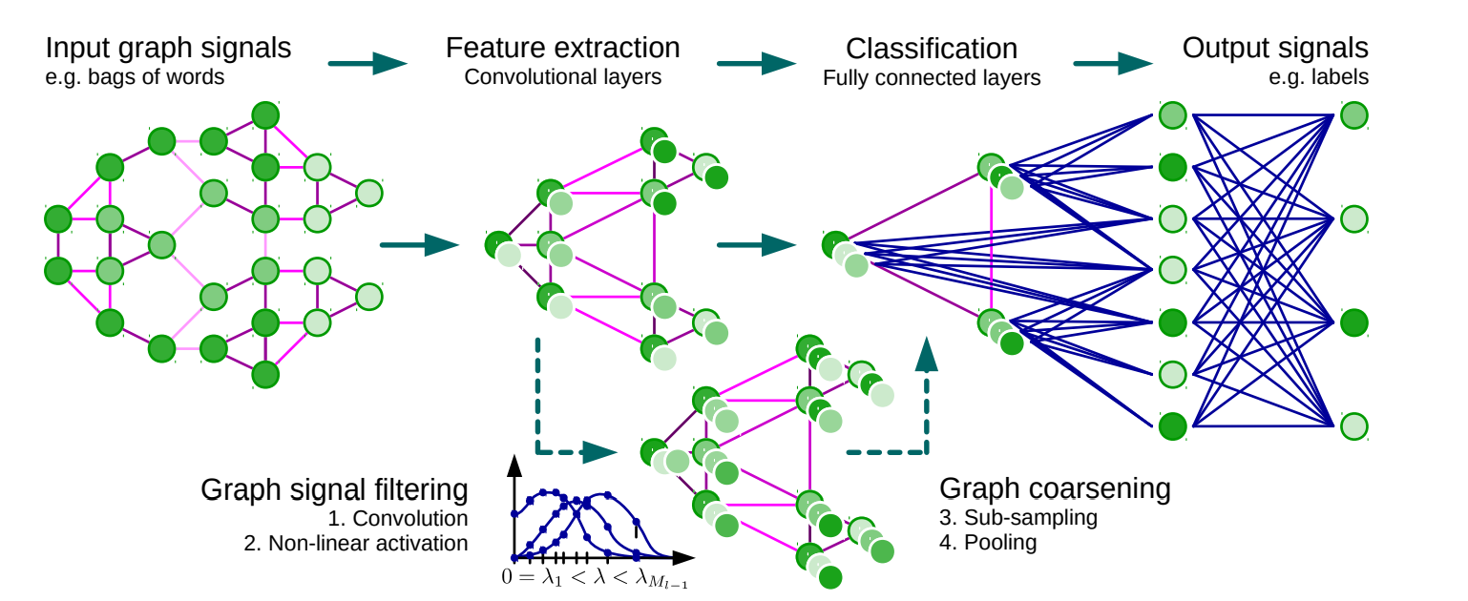
Graph Neural Network(GNN) [14][15][16]
Convolutional Neural Networks
Instead of multiplication they do filtering
We could do this filtering in Graph Domain
Convolutional Neural Networks in Graph Domain for Graph Classification
Much more details
Convolution is for a graph signal
not a graph ☹
Classify each node then FC
Classify by Convolution on
Fourier Basis then FC
Normal Neural Network
Convolutional Neural Network

Slide 25
References
Einizade, Aref, et al. "Neural decoding of imagined speech from EEG signals using the fusion of graph signal processing and graph learning techniques." Neuroscience Informatics 2.3 (2022): 100091. [1]
Mathur, Priyanka, and Vijay Kumar Chakka. "Graph signal processing of EEG signals for detection of epilepsy." 2020 7th International Conference on Signal Processing and Integrated Networks (SPIN). IEEE, 2020. [2]
Wendling, Fabrice, et al. "From EEG signals to brain connectivity: a model-based evaluation of interdependence measures." Journal of neuroscience methods 183.1 (2009): 9-18. [3]
Kalofolias, Vassilis. "How to learn a graph from smooth signals." Artificial Intelligence and Statistics. PMLR, 2016. [4]
López, Rafae Lemuz, et al. "Graph theory for brain connectivity characterization from EEG." 2020 10th International Symposium on Signal, Image, Video and Communications (ISIVC). IEEE, 2021. [5]
Mathur, Priyanka, and Vijay Kumar Chakka. "Graph signal processing based cross-subject mental task classification using multi-channel EEG signals." IEEE Sensors Journal 22.8 (2022): 7971-7978. [6]

Slide 26
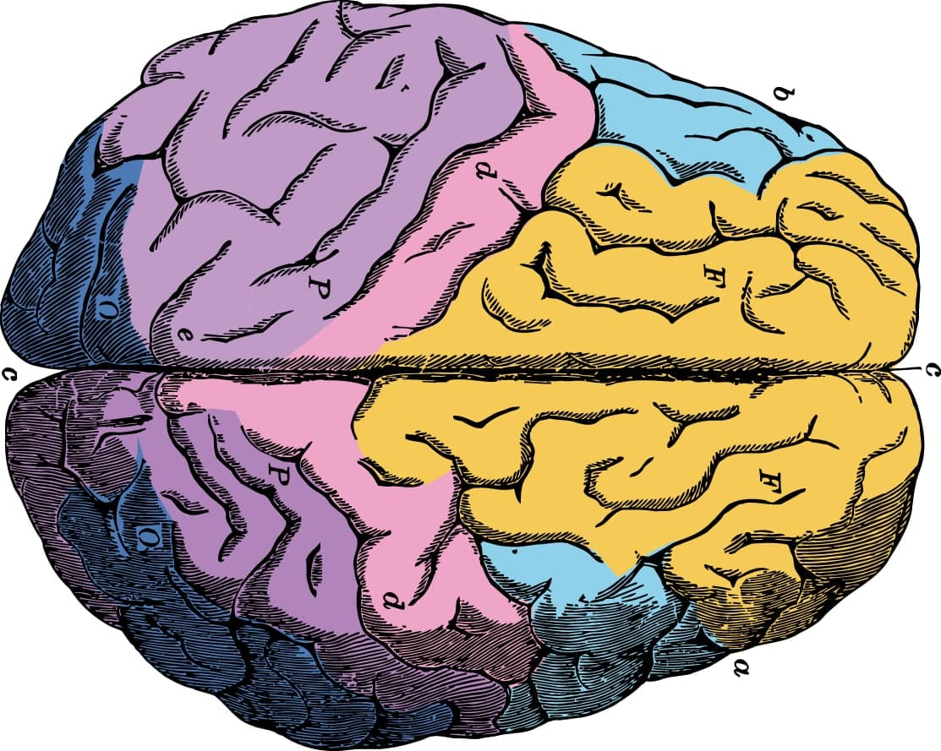
Thanks for Your Attention!

